Slide 1

Elements of Outreach:
Strategic Marketing to the
Disability Community
February 12th, 2015

Slide 2
It’s a
safe space
here!

Slide 3


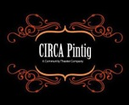


The Elements of Outreach:
Strategic Marketing to the Disability Community
Presenters
Rooshey Hasnain, Ed.D. and Angela Mascarenas, Ph.D.
Contributing Research Interns
Christopher Tran and Alireza Karduni
Contributing Artists
Alfred Tsao, Mr. Mohammed (Moe) Ganim
Chicago Cultural Accessibility Consortium (CCAC)
Thursday, February 12, 2015
3:30 PM to 5:30 PM

Slide 4

VALUE OF ARTS AND CULTURAL PARTICIPATION
Arts participation is a human right
United Nations Universal Declaration of Human Rights:
“Everyone has the right to freely participate in the cultural life of the community and to enjoy the arts” (1948)
http://www.culturaldevelopment.net.au/wp-content/uploads/2010/03/Kim-Dunphy-Arts-Activated-conference-presentation-compressed-copy.pdf

Slide 5
Today’s Presentation:
Where Are We Heading?
Part 1: Defining Outreach and Supporting Legislation
Part 2: How Can We Use Outreach
Part 3: Introducing Our Outreach Framework and Tactics at UIC
Part 4: Highlighting Some Model Practices
Part 5: Spotting A Partnership: CIRCA-Pintig: (A Multi-Cultural Community Arts Organization Perspective)

Slide 6
How Do We Define “Outreach”?
“A systematic attempt to provide services beyond conventional limits [for] particular segments of a community”
(American Heritage Dictionary, 1984)
In terms of advocacy: “Reaching out and assisting through personal contacts with people excluded from, unaware of, or unreceptive to [commonly used] information or services”
What outreach encompasses: Research, education, services, events, and cultural spaces within the broad community

Slide 7
UNITED NATIONS CONVENTION
ON THE RIGHTS OF PERSONS WITH DISABILITIES
According to Article 30:
Governments must recognize the rights of individuals with disabilities to participate with others in cultural life on an equal basis
All appropriate measures should be taken to ensure that persons with disabilities enjoy access to:
  Films, theater, and other cultural events
  Supporting cultural materials in accessible formats
  Venues where cultural performances or services are held (theaters, museums, cinemas, libraries, tourism facilities, monuments, sites of national and cultural importance)
http://www.culturaldevelopment.net.au/wp-content/uploads/2010/03/Kim-Dunphy-Arts-Activated-conference-presentation-compressed-copy.pdf

Slide 8
ADA AND REHABILITATION ACT OF 1973
Legislative actions in the U.S.
The Americans with Disabilities Act of 1990:
  Cultural organizations, regardless of whether they receive federal financial assistance, or whether they are public or private entities, must not discriminate against individuals with disabilities.
The Rehabilitation Act of 1973:
  Cultural organizations, private or public, that receive direct or indirect federal funds or federal financial support must make programs, services, and activities accessible, including employment opportunities

Slide 9
Recent Research Findings: What Stakeholders Are Saying About Barriers to Participation at Cultural Venues
The impact of people with disabilities
Despite good practices by many arts and cultural organizations, accessibility is the main environmental barrier to preventing people with disabilities from participating in arts and cultural events
Focus group have found 2 recurring themes contributing to these barriers:
  the lack of awareness of accessibility and disability-related issues
  the need for inclusive and accessible policies
  People with disabilities are often disconnected from managers of cultural organizations and city leaders: How this could be improved:
  Raise awareness about disabilities and accessibility
  Implementing inclusive policies
  (Michigan, 2014)

Slide 10

A Case Example on Non-Compliance:
How the National Museum Was Directed to Improve Access for People with Disabilities
In 2015, the Justice Department, in response to complaints, ordered the Crime and Punishment museum to take several steps to ensure that all of its programs, exhibits, and facilities are accessible to people with disabilities by providing:
Staff assistance or pre-recorded audio description of program and exhibit information for patrons who are blind or have low vision
Printed copy of program information that is not currently available for patrons who are deaf or hard of hearing;
Audio-described and tactile experiences in museum tours that are for individuals who are blind or have low vision
Use of alternate formats in printed materials, floor plans and maps in (audio, large print and Braille)
Use Web Content Accessibility Guidelines 2.0 for arts organization websites
Removal of physical barriers (e.g., protruding objects, inaccessible routes and restroom barriers)

Slide 11
Key Aims of Our Work
…Increase opportunities for people with disabilities to participate in the arts as artists or patrons
…Encourage arts support staff and leadership to develop effective outreach capacities
…Share various outreach and partnership strategies based on our research-informed model practices

Slide 12
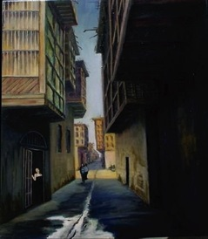
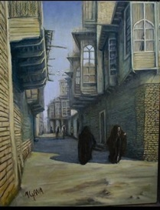
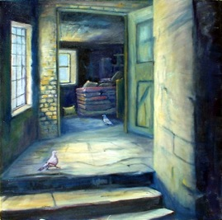
How Do You Currently Use Outreach?
Do you use outreach to:
Partner with artists with disabilities to co-teach art in cultural spaces?
Outreach to people with disabilities who are from immigrant, refugee or minority backgrounds?
Engage people with disabilities as event participants, board members, consultants or employees?
Ensure that your cultural spaces are accessible?
Disabled individuals of such groups can offer a unique perspective to our work but often are an untapped resource.
Notes:
12

Slide 13
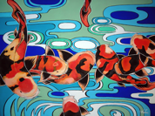
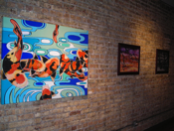
The Challenges and Opportunities to Diversify Cultural Spaces
People with disabilities are often less likely than others to attend various art events and cultural spaces
Many cultural spaces do not adequately engage people with disabilities from minority/immigrant populations
Accessible materials and outreach strategies can be developed that are sensitive to people with disabilities
We are working to change these shortcomings by finding ways to partner with people with disabilities and thereby expand inclusionary practices

Slide 14
The Value of Engaging People With Disabilities
AND UNDER-TAPPED GROUP
Of the 20% of adults with disabilities in the U.S., almost 1 in 5 are potential customers for disability-friendly businesses, including various art venues
People with disabilities are a large and growing market, with $175 billion in discretionary spending
Studies suggest that people with disabilities dine out at least once a week, spending about $35 billion per year
Travelers with disabilities spend over $13.6 billion annually
Source: ACS, 2004, U.S. Department of Justice, Expanding your Market...Customers with Disabilities
Bottom line: Art venues can enhance their success by integrating people with disabilities into their organization whether as patrons or staff Source: Solutions Marketing Group, USBLN National Conference, November 2005 Pittsburgh, PA

Slide 15
Today’s Key Question
How can we ensure that all Chicagoans with a disability are given opportunities to engage fully in the arts and cultural spaces?

Slide 16

Ten Outreach Strategies Being Used to
Improve Participation of PWDs in Cultural Institutions
10-Offer Educational Training/Workshops
9-Diversify your Staff and Board Membership
8-Mobilize Coalitions and Task Forces
7-Develop Grassroots Leadership
6-Offer Inclusive and Accessible Services
4-Engage with Ethnic, Mainstream, and Social Media
2-Conduct Community Outreach and Collaboration
3-Strengthen Language and Linguistic Capacities
5-Collect Satisfaction Surveys and Participant Feedback
1-Define and Characterize
Your Local community
Increase
Participation of
PWDs
In cultural venues
Notes:
16

Slide 17
High Impact Outreach Strategies

Slide 18

Outreach Strategy #1
Define and Characterize Your Local Community

Slide 19
How to Begin:
Simple Steps to Outreaching to Multicultural Communities
Conduct an asset-based assessment to determine:
-- prevailing needs, attitudes, demographics
-- media environment,
-- barriers and opportunities of different groups
Develop and implement an outreach plan to engage with diverse and non-traditional groups
Identify key champions and convene partners/ stakeholders, including people with disabilities of diverse cultures and backgrounds

Slide 20
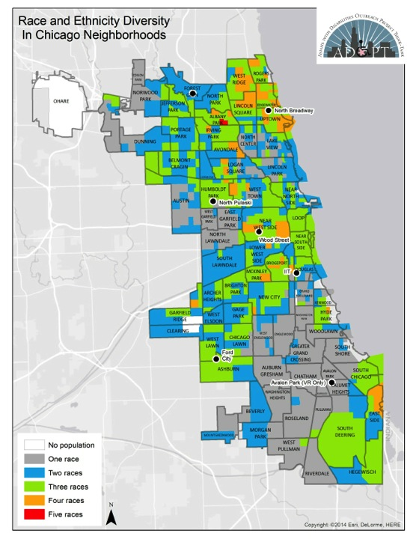
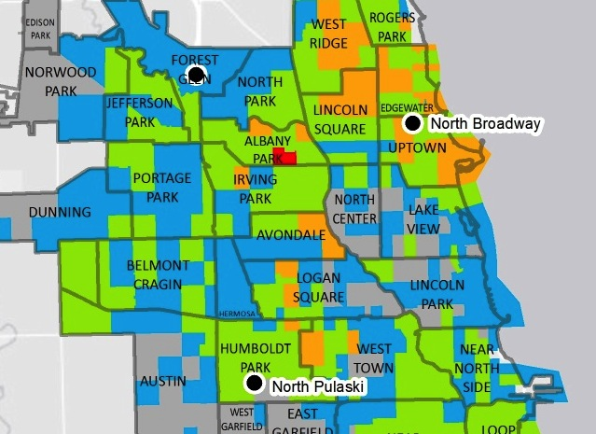
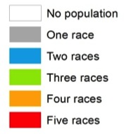

Slide 21
DEVELOPING AN ACTION-ORIENTED
OUTREACH MODEL
Define and Characterize the Local Arts, Disability, and Multicultural Communities
Involve KEY Stakeholders
Improve Arts Participation
Monitor
Progress &
Outcomes
Identify Barriers
& Facilitators

Slide 22
Disability by Race & Ethnicity in the U.S.
Race/Ethnicity | Percent of Total Population | Percent with a Disability | Percentage with a Disability (65 and older)
European American | 74.34% | 12.40% | 35.87%
Hispanic/Latino American | 16.39% | 8.30% | 41.30%
African American | 12.33% | 13.70% | 43.43%
Asian American | 4.86% | 6.40% | 32.23%
American Indian and Alaskan Native | 0.81% | 16% | 51.12%
Native Hawaiian and other Pacific Islander | 0.16% | 9.40% | 41.71%
TOTAL: |  | 11.03% | 40.94%
Source: ACS 2012 5-year estimates

Slide 23
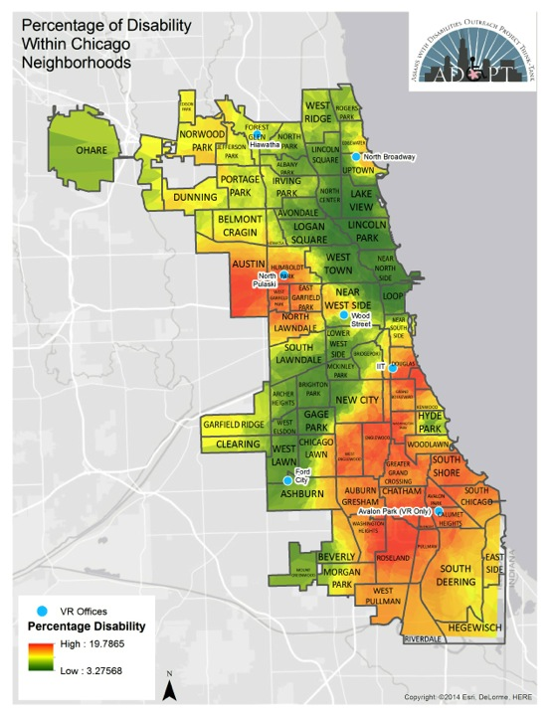
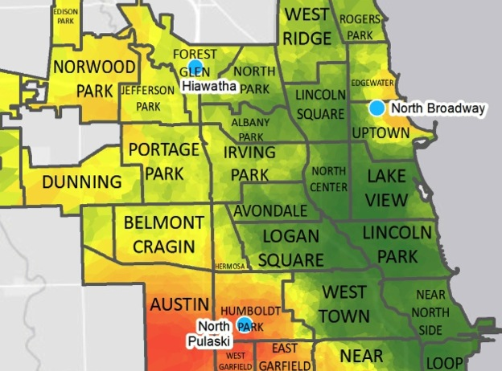
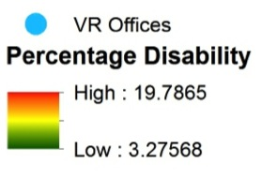

Slide 24
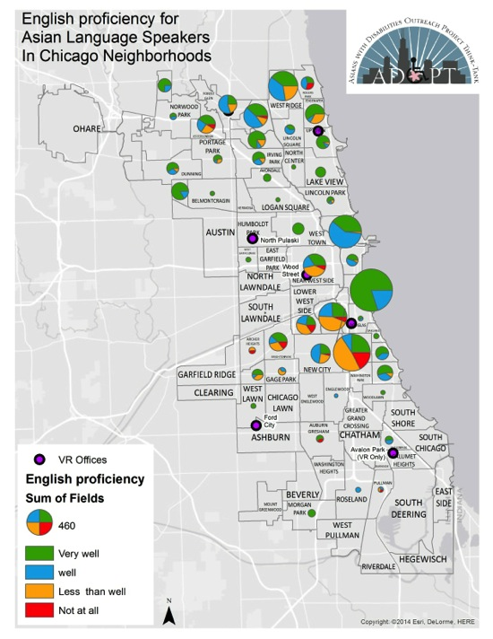
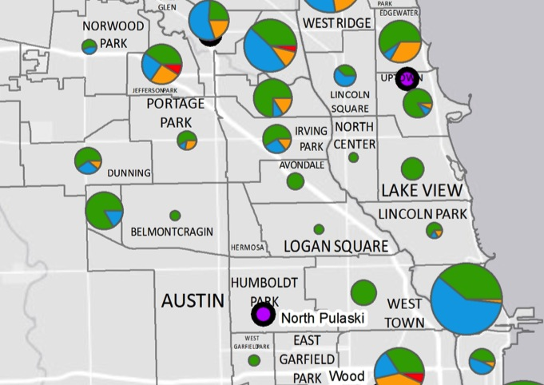
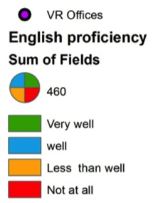

Slide 25
Outreach Strategy # 2
Conduct Community Outreach and Collaboration

Slide 26

Building Community Partnerships & Collaborations
01
02
03
04
04
KEY STAKEHOLDERS IN
PARTNERSHIPS & COLLABORATION
PWDs & Their Families
CBOs & FBOs
Business owners &
Chambers of Commerce
City Officials & Politicians
Disability Groups & Orgs.
Educational Institutions
Ethnic Media
ADA/Accessibility Content Experts

Slide 27




What kinds of COMMUNITY organizations or groups do you
wish to partner with as a means to diversify your outreach?

Slide 28
Outreach Strategy # 3
Strengthen Language and Linguistic Capacities

Slide 29
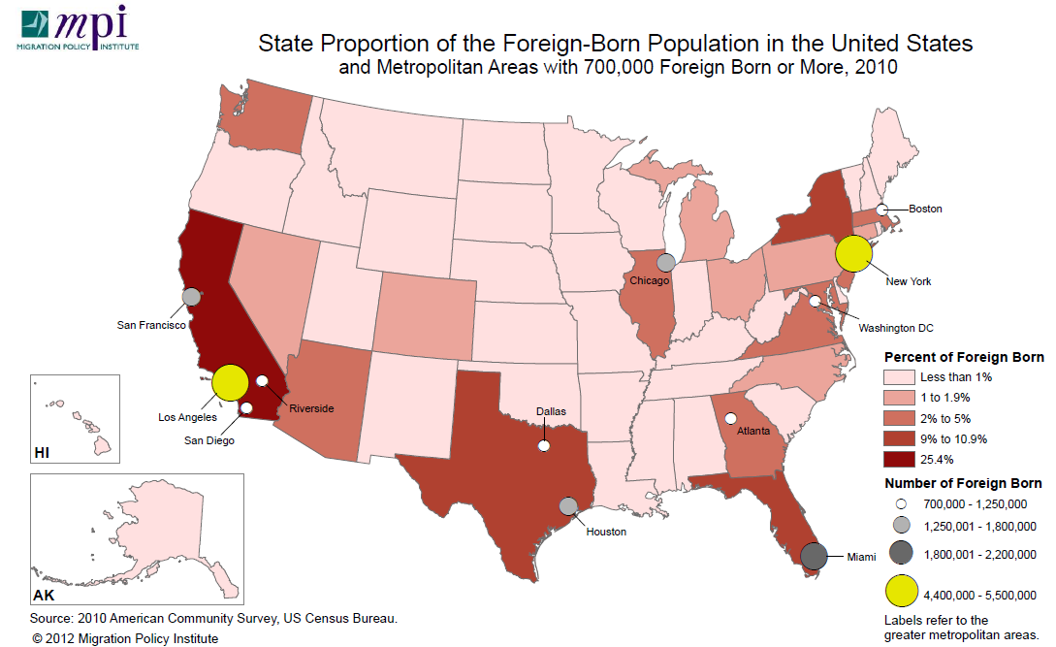

Slide 30
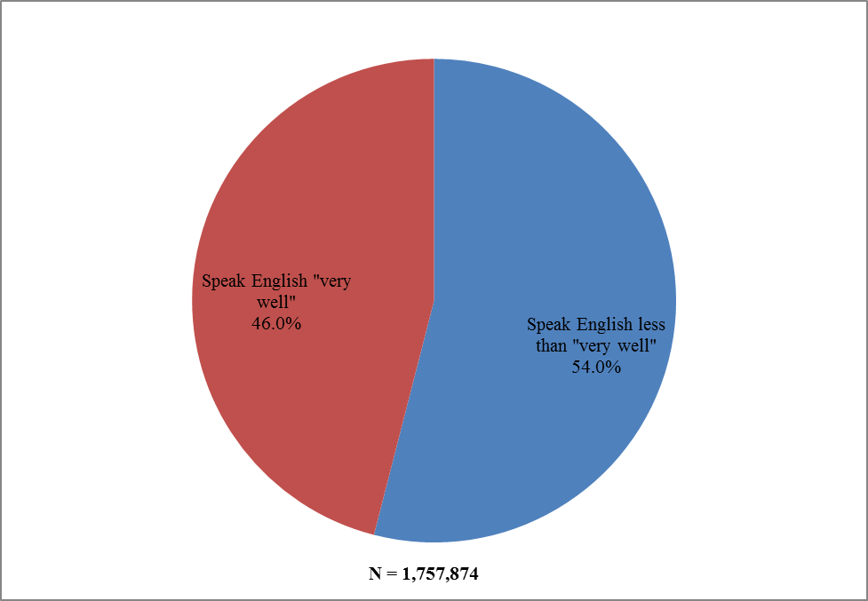
Foreign Born Populations in IL by Ability to Speak English

Slide 31

Language Access Efforts
ADOPT’s Language preference selection for online and onsite referral form
  Translated DRS-VR fact sheets
      13 languages
  Audio accessible fact sheets
      Hindi clip Tagalog Clip

Slide 32
Outreach Strategy # 4
Engage with Ethnic, Mainstream, and
Social Media Outlets

Slide 33
Raising Awareness Through Media and Cultural Arts
Press releases, press conferences, and town hall meetings
Gaining access to ethnic media in a culturally appropriate way
Raising awareness and gathering personal stories through unconventional methods

Slide 34
Outreach Strategy # 5
Conduct Satisfaction Surveys and Gather Participant Feedback
Participant Feedback

Slide 35
1. Develop a baseline of current patrons, participants and partners
2. Improve our understanding needs and strengths pertaining to the arts and of people with disabilities
Data Collection
Goal: Collect satisfaction surveys from people with disabilities who want to access arts events and venues
3. Collect success stories of cultural institutions that are proactive in recruiting PWDs to their venues
4. Identify new and creative outreach mechanisms to better engage people with disabilities and their allies
Notes:
35

Slide 36
Outreach Strategy # 6
Offer Inclusive and Accessible Services and Events
What are your organizations currently doing to address inclusive and accessible practices?

Slide 37
Outreach Strategy # 7
Develop Grassroots Leadership

Slide 38
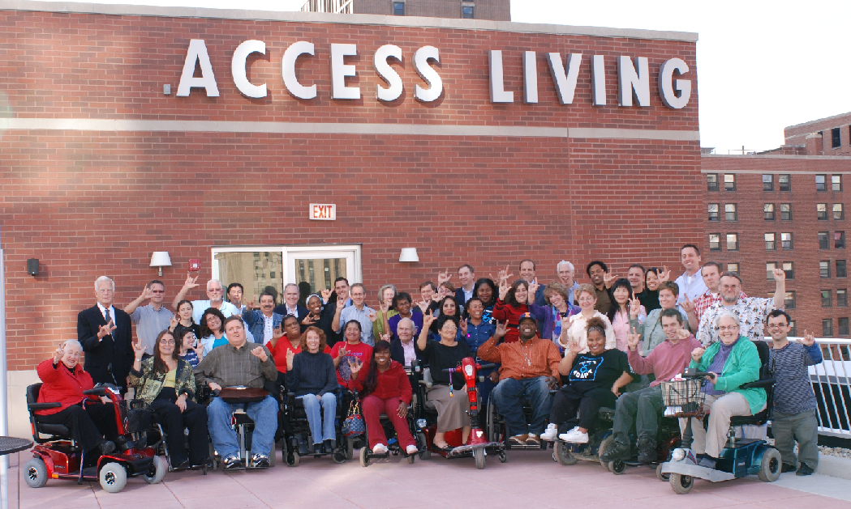
Building Community Partnerships & Collaborations
01
02
03
04
It is imperative to collaborate with disability groups and organizations in any partnerships that involves people with disabilities because they often remain unconnected unless active outreach efforts are in place.
The primary goal of disability groups and organizations is the betterment for such people. They actively promote disability rights and inclusion at all levels.
These entities are strong promoting disability rights in social, economic, and political arenas, but are week in addressing cultural and immigrant issues.
Disability Groups

Slide 39
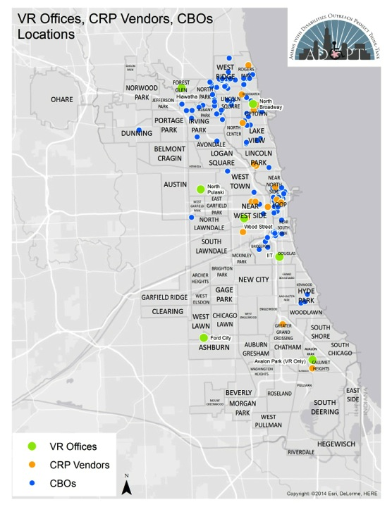
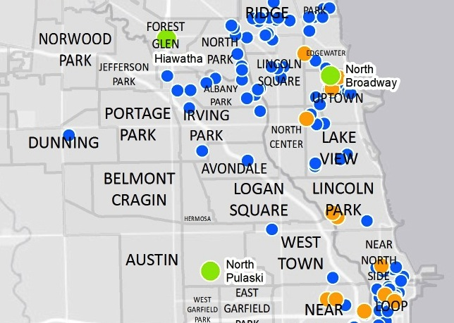
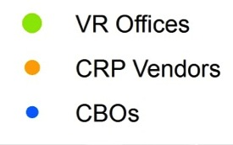
Notes:
This map shows where disability offices, VR, and CBOs reside.

Slide 40
Outreach Strategy # 8
Mobilize Advisory Boards, Committees, and Task Forces

Slide 41
What Has Been the Impact of
Our Outreach Efforts and Collaboration?
It has helped organizations to:
Mobilize resources and influence systems
Promote new relationships among previously disconnected individuals with disabilities and families
Serve as catalysts for changing programs, practices, and policies
Evaluate and revise outreach plan

Slide 42
Outreach Strategy # 9
Diversify Your Staff and Board Development
Determine staffing and board membership needs and opportunities
for all levels of your cultural venue

Slide 43
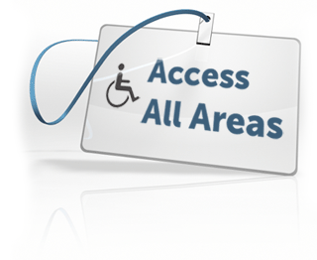


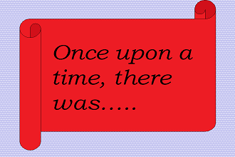
Diversify Your Current Workforce by
Partnering With Nontraditional Cultural Institutions
Multicultural, multilingual
Accessible
Engaging
Storytelling

Slide 44
Outreach Strategy #10
Offer Consultation and Educational Workshops with People with Disabilities as Co-Presenters
Engage and work with local artists with disabilities and multicultural
groups and institutions
Broaden you expertise about disability, accessibility and multicultural diversity
Build partnerships with people with content expertise
Consider diversifying in all areas of arts participation
Notes:
.

Slide 45

Spotlight on a Partnership: A Case Example
  CIRCA-Pintig: Founded in April 1991 to serve as a voice of the Filipino American/pan Asian American community, this group engages in active cultural works by using artistic performances to celebrate the community’s rich history and culture
  “Silencing Stigma, Speaking Out”: Created by CIRCA Pintig in collaboration with students, faculty/staff and community activists
  (Spring, 2014)
Silencing Stigma: Speak Out
93 in attendance
7 partnerships
Notes:
Sheewin
Small Dark Room
75 in attendance 25 partnerships
Silencing Stigma
93 in attendance 7 partnerships
Falling Petals
Overall 225 in attendance 2 partnerships

Slide 46
CIRCA-Pintig-UIC ASAM
A Community Arts Organization
CIRCA-Pintig is committed to engaging community dialogues through participatory theatre.
The 3 main components of its work are:
Education and Civic Reflection
Performances, Workshops and Training
Organizing and Mobilizing community resources for creative problem solving
* It provides a safe space and a repertoire of tools for the collectively reflecting on & interrogating pressing issues. Performances are rehearsals for broader community engagement and action.

Slide 47
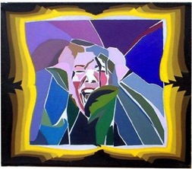
The Benefits of Reaching Out To A
Multicultural Arts Organizations
Inclusive spirit in philosophy and practice
Proactive in seeking multi-cultural/multi-lingual performers
Openness to learn and hear stories from multi-cultural communities
Diversifying worldviews
Respect for authenticity

Slide 48
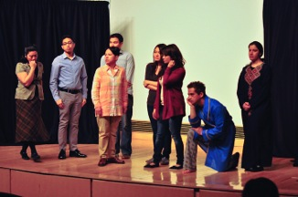
Why is it important for mainstream arts community and disability leaders to connect with and be inclusive of multi-cultural communities in their work?
Communication with disabled individuals from other cultural background is difficult but not impossible.
Part of the communication process is finding individuals from other cultural backgrounds who are willing and capable of bridging the gap between main stream culture and their culture or community.
Need knowledge of the cultural background.
Listening to people not just talking to them.

Slide 49
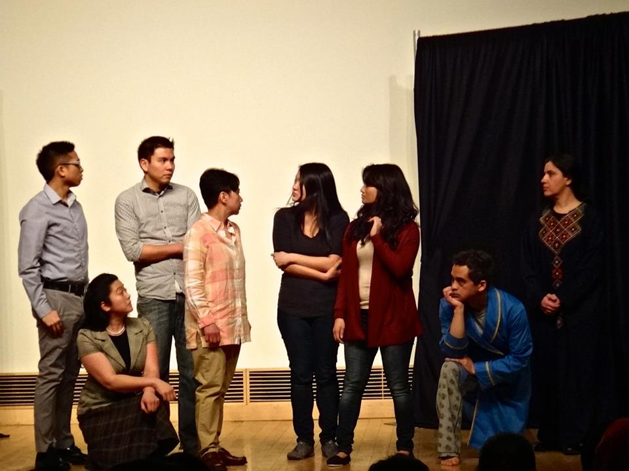

Slide 50
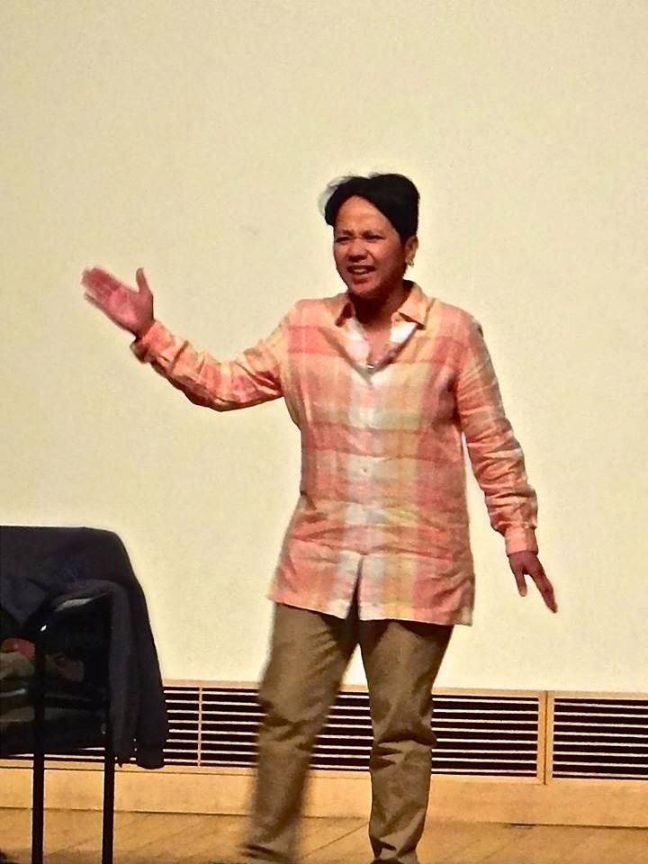
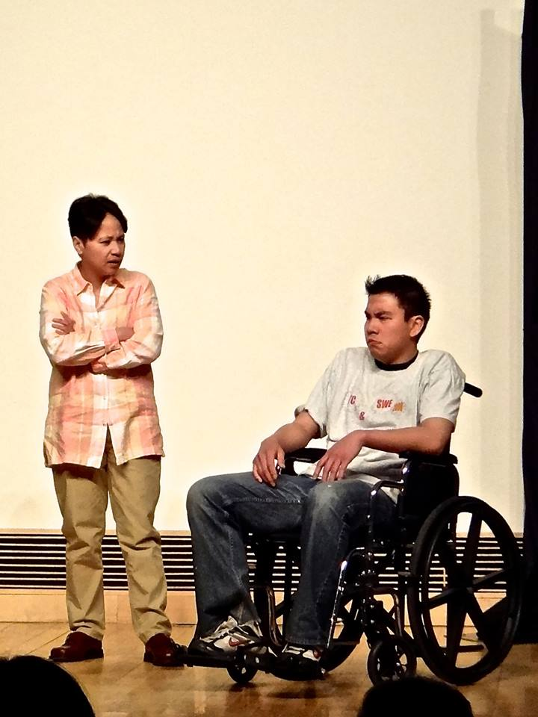

Slide 51
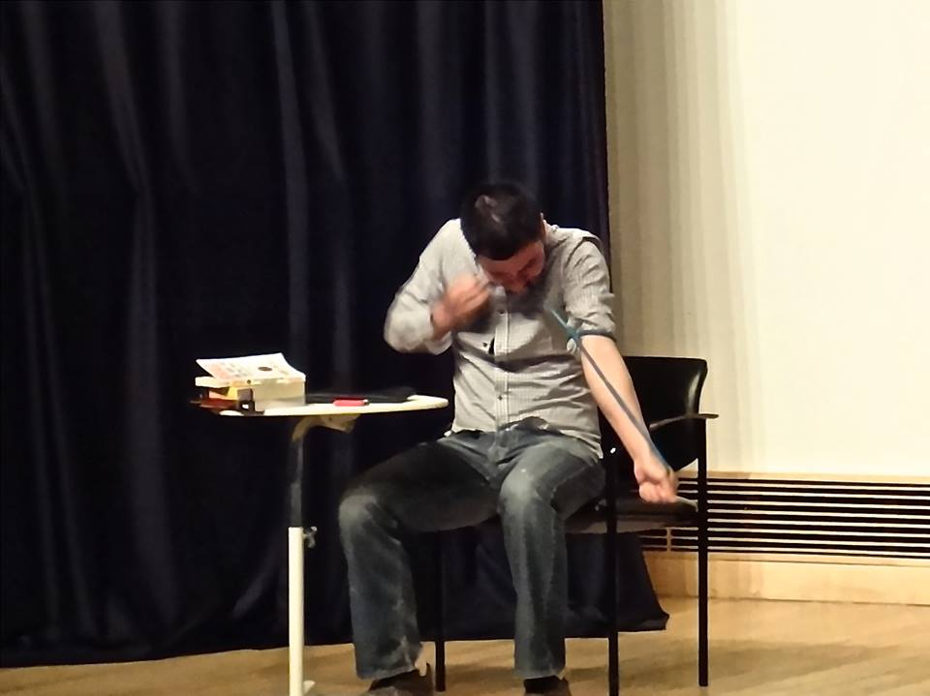
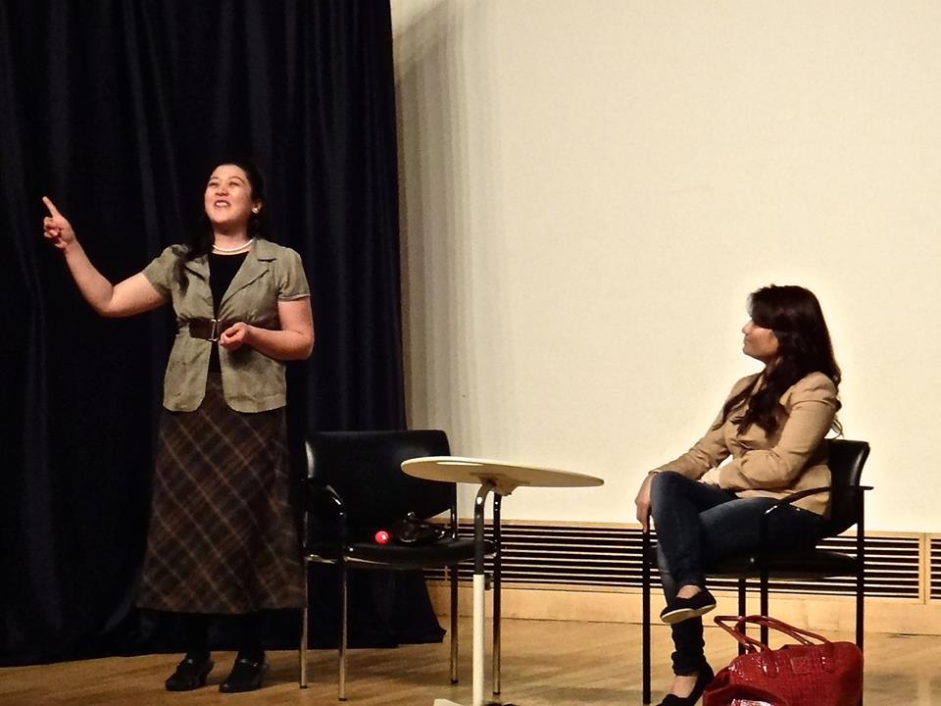

Slide 52
CIRCA-PINTIG:
Lessons From An Outreach Collaboration
Communities are a vital source and wellspring of stories and ideas. BUT we have to ask.
Especially for sensitive issues (e.g. mental health issues, undocumented status, etc.), the arts are very valuable for providing the creative and culturally-sensitive approaches and tools for expression and problem-solving.
Anybody can participate according to each one’s comfort level, resources, interests and capacities. These at-risk, vulnerable and under-resourced communities are very generous. Again, we just have to ask.
Keep the community dialogues/conversations going. This is constant work-in-progress.

Slide 53
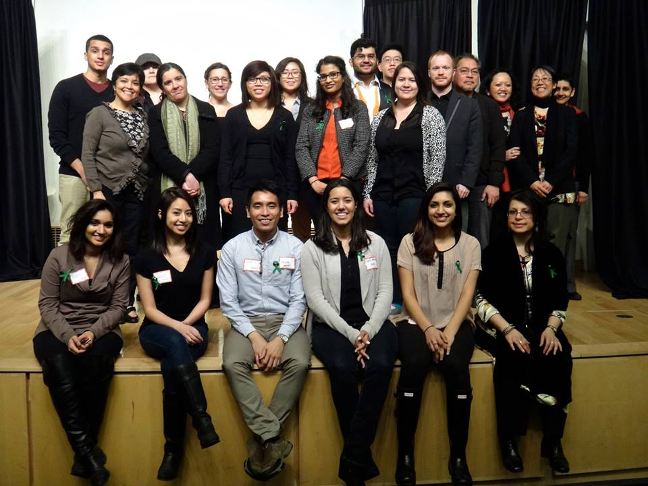

Slide 54
Next Steps
Broker relationships with minority/immigrant/refugee organizations and disability organizations, as well as with cultural institutions
Initiate meetings with ethnic or issue based organizations to increase awareness of cross-cultural disability issues and the arts
Increase outreach to minority populations with disabilities using different languages and alternative approaches to ensure effective communication
Hold forums addressing disability issues that affect minority/ populations in settings (art venues) that are fully accessible to persons with disabilities
Establish relationships with universities or other research agencies that partner with minority populations with disabilities to ensure adequate and appropriate data collection processes
Monitor progress within partner agencies to ensure the participation of minority persons with disabilities in all aspects of programming, service delivery, and/or research

Slide 55

CONTACT INFORMATION
Rooshey Hasnain, Ed.D.; University of IL at Chicago (UIC)
Department of Disability and Human Development
Asian American Studies Program
  Phone: 312.413-0416 | e-mail: roosheyh@uic.edu
Angela Mascarenas; CIRCA-Pintig
E-mail: gingmasca@gmail.com

Slide 56
Thanks!

Slide 57



Chun-Shan (Sandie) Yi
UIC, Ph D student in Disability Studies
Bodies of Work: Network of Disability Arts and Culture
Access Living
CCAC
Contact: cyi9@uic.edu

Slide 58
Why social media?
Limited budget
Technology creates access
Online Support Network:
Disability and Deaf community
online “family”

Slide 59
Check List:
Publicity graphic design: Accessibility v.s. Aesthetics
E-mail attachment: one PDF + one plain text (txt) file
E-mail body: include text version of the information and visual elements.
Send out publicity at least 15 days in advance. (Reserve rides, request disability accommodations and personal assistant, etc)
Provide disability accommodation info

Slide 60
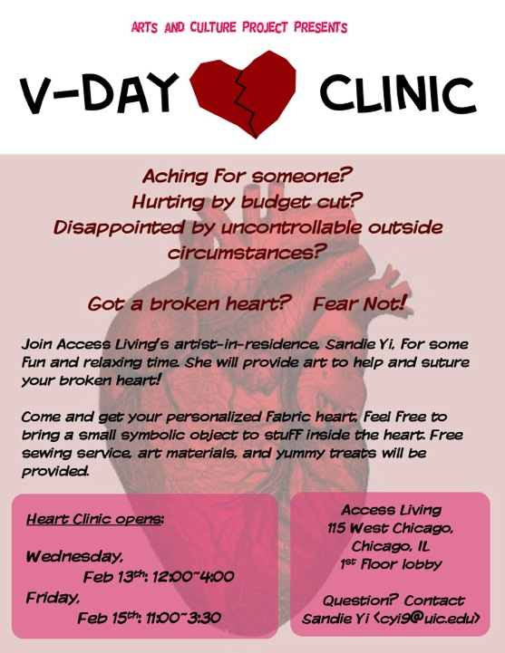
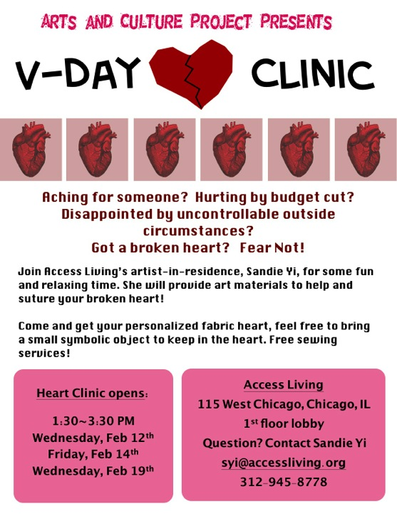

Slide 61
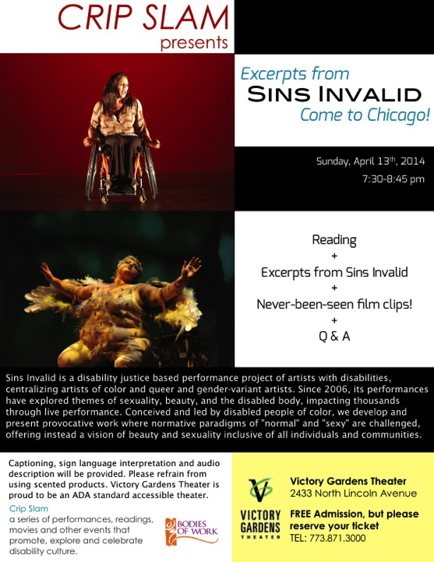
Crip Slam Presents Excerpts from Sins Invalid Come to Chicago!
Sunday, April 13th, 2014
7:30-8:45 pm
Reading + Excerpts from Sins Invalid + Never-been-seen film clips! + Q & A
-------------------------------------
Sins Invalid is a disability justice based performance project of artists with disabilities, centralizing artists of color and queer and gender-variant artists. Since 2006, its performances have explored themes of sexuality, beauty, and the disabled body, impacting thousands through live performance. Conceived and led by disabled people of color, we develop and present provocative work where normative paradigms of "normal" and "sexy" are challenged, offering instead a vision of beauty and sexuality inclusive of all individuals and communities.
-------------------------------------
Victory Gardens Theater_2433 North Lincoln Avenue
FREE Admission, but please reserve your ticket
TEL: 773.871.3000
Captioning, sign language interpretation and audio description will be provided. Please refrain from using scented products. Victory Gardens Theater is proud to be an ADA standard accessible theater.
Crip Slam
a series of performances, readings, movies and other events that promote, explore and celebrate disability culture.
This event is brought to you by:
Victory Gardens Theater and Bodies of Work: Network of Disability Arts and Culture

Slide 62
Disability Accommodation Text example:
The event space is accessible to wheelchair users and people who need to avoid stairs. This event provides personal assistants, Audio Descriptions and large font reading materials.
To request accommodations, please contact______ by _ date__

Slide 63
Creating allyship with people with disabilities!
Fundraising vs Friend-raising
Snail Mail
Make Calls
Build personal connections and community relationships

Slide 64
Brainstorm: Outreach Strategies
Show & Tell! Got a flyer from your organization? How can you make it more accessible?
Share your outreach strategies.
What new outreach strategies inspire you today?

