Slide 1
Providing Services and Programming for Guests Who Are Deaf or Hard of Hearing
May 27, 2014

Slide 2
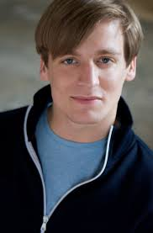
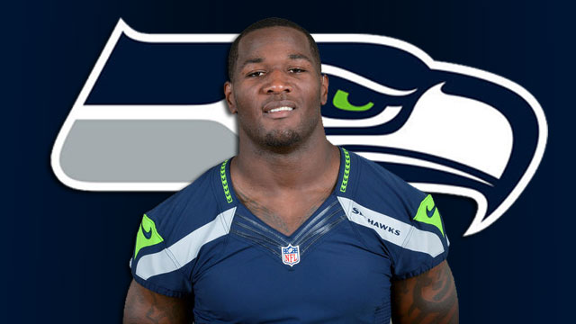
Familiar Deaf/Hard-of-Hearing Faces
Notes:
Marlee Matlin – well known, first to win academy award
John McGinty – at Tribes – ask – how many people saw Tribes?
Derrick Coleman, deaf football player on Seattle Seahawks, great role model

Slide 3
Terminology
Use the terminology the person with a hearing loss uses:
Deaf/deaf
Hard of hearing
Late deafened
Hearing loss
Note: “hearing impaired” – many still use it, but no longer in vogue
“Legally deaf” is not a term

Slide 4
Communication
Hear through assistance of hearing aid, cochlear implant
Speak and lip read
American Sign Language (ASL)
Sign and voice at same time
Cued speech

Slide 5
Technology
Hearing aid
Cochlear implant
FM system
Assistive listening devices
Use T-switch (on most hearing aids and Cis) to connect to induction loop

Slide 6
Identity
No black and white – all individuals with hearing loss have distinct life experiences
Culturally deaf/Deaf – some identify with deaf community, some do not
Deaf Community – use ASL, cultural norms such as bluntness (can be interpreted as being rude but is not intended)
Word-of-mouth communication about events, people, organizations

Slide 7
Identity (2)
Hard-of-hearing community
Speaking deaf community
Often, one who does not identify as Deaf or use ASL, may be offended if signed to
Not all deaf/hoh know ASL or use ASL

Slide 8
Education
Mainstream education
With or without accommodations
Real-time captioning, ASL interpreters, note takers, FM systems, seat in front of class; private or public schools
Mainstreamed at a school with a large deaf program
Deaf Institute – Illinois School for the Deaf in Jacksonville, IL

Slide 9
How to Communicate
Make eye contact – lip reading takes cues from face and body
Don’t over-enunciate
If person doesn’t understand what you are saying, try rephrasing it in a different way
If person wants to write notes, grab pen and paper

Slide 10
More Communication Tips
Be aware of light
Be aware of acoustics – background noise is hard to hear in, move to quieter space if possible
Knowing the ABCs in ASL will come in handy

Slide 11
Americans with Disabilities Act 101
Intent of the ADA
Prevent discrimination
Create equal opportunities
ADA has 5 Titles
Title II – applies to government entities and government funding
Title III – applies to places of public accommodation
Note: may have add’l obligation to provide access if you receive government funding, e.g. under Section 504 of Rehab Act

Slide 12
Title III categories that apply to cultural institutions
Places of exhibition or entertainment (motion picture houses, theaters, concert halls, stadiums)
Places of public gathering (auditoriums, convention centers, lecture halls)
Places of public display or collection (museums, libraries, galleries)
Places of education (schools)

Slide 13
Obligation to provide Auxiliary Aids
(a) General. A public accommodation shall take those steps that may be necessary to ensure that no individual with a disability is excluded, denied services, segregated or otherwise treated differently than other individuals because of the absence of auxiliary aids and services, unless the public accommodation can demonstrate that taking those steps would fundamentally alter the nature of the goods, services, facilities, privileges, advantages, or accommodations being offered or would result in an undue burden, i.e., significant difficulty or expense.

Slide 14
What is Effective Communication?
A public accommodation shall furnish appropriate auxiliary aids and services where necessary to ensure effective communication with individuals with disabilities.
Effective communication means whatever is written or spoken must be as clear and understandable to people with disabilities as it is to people without disabilities.
Entities are encouraged to consult with individuals with disabilities on what effective accommodations are.

Slide 15
Auxiliary Aids include:
Assistive listening systems and devices
Open and closed captioning, real time captioning
Qualified interpreters (ASL, oral, cued speech)
Written materials
Script
Assistive listening systems and devices

Slide 16
The “But it’s too expensive” excuse
Entities are responsible for covering the cost of accommodations, and cannot charge the individual requesting the accommodation (ex – by charging higher ticket price). To do so is a violation of the ADA.
ADA says entities must provide access unless it would result in fundamental alteration or undue burden. Both are hard to prove.
For example - paying for cost of ASL interpreters will not cause your institution to go bankrupt
Alt. funding sources available – grants, fundraising, budgeting
Setting up captioning/ASL interpreters for one performance each show is not a fundamental alteration

Slide 17
DOJ Proposed Rulemaking
http://www.ada.gov/anprm2010/movie_captions_anprm_2010.htm
DOJ soliciting comments on Title III regulations on movie theater captioning and audio description adding regulations
Regulations will apply to captioning and audio description in movies – could have implications for other institutions

Slide 18
Resources
DOJ Factsheet on Effective Communication (revised January 31, 2014) http://www.ada.gov/effective-comm.htm
Ada.gov
DOJ Regulations on the ADA http://www.ada.gov/taman3.html

Slide 19
Providing Services and Programming for Guests Who Are Deaf or Hard of Hearing
May 27, 2014

Slide 20
Whitney Museum of American Art
The Vlog Project
http://whitney.org/Education/Access/Vlogs

Slide 21
Smithsonian American Art Museum
Art Signs – Gallery Talks in American Sign Language
http://americanart.si.edu/education/asl/

Slide 22
Providing Services and Programming for Guests Who Are Deaf or Hard of Hearing
May 27, 2014

Slide 23
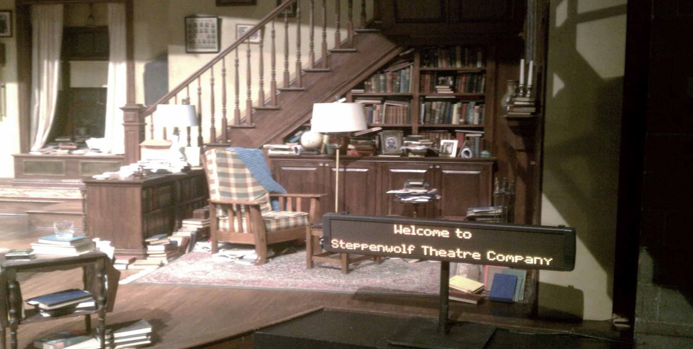
Open Captioning
Steppenwolf Theatre Company

Slide 24
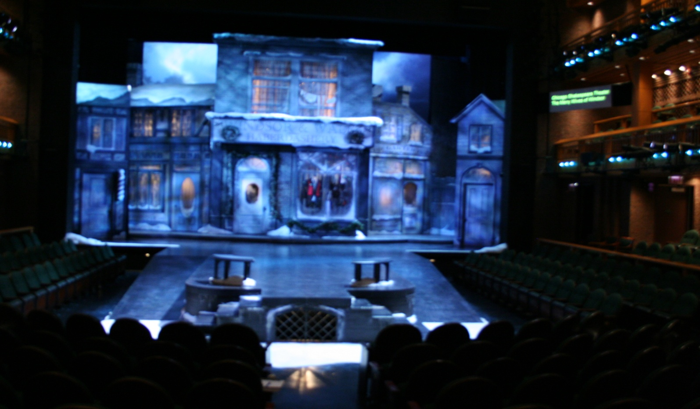
Open Captioning
Chicago Shakespeare Theater

Slide 25
Providing Services and Programming for Guests Who Are Deaf or Hard of Hearing
May 27, 2014

Slide 26
Thank you for attending!
For more information:
http://chicagoculturalaccess.weebly.com

