Slide 1
Sensory Processing Disorder (SPD) and Arts & Culture
By Rachel S. Schneider, M.A., MHC
Author of Making Sense: A Guide to Sensory Issues
SPD Adult and Advocate

Slide 2
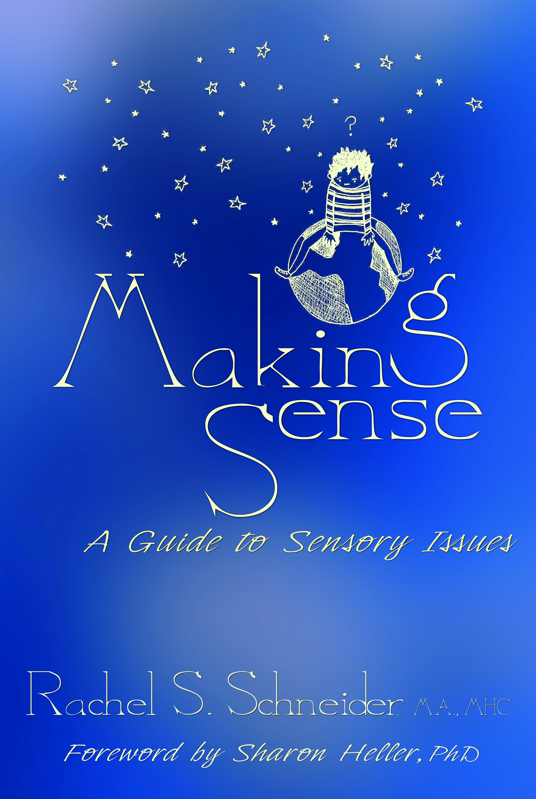
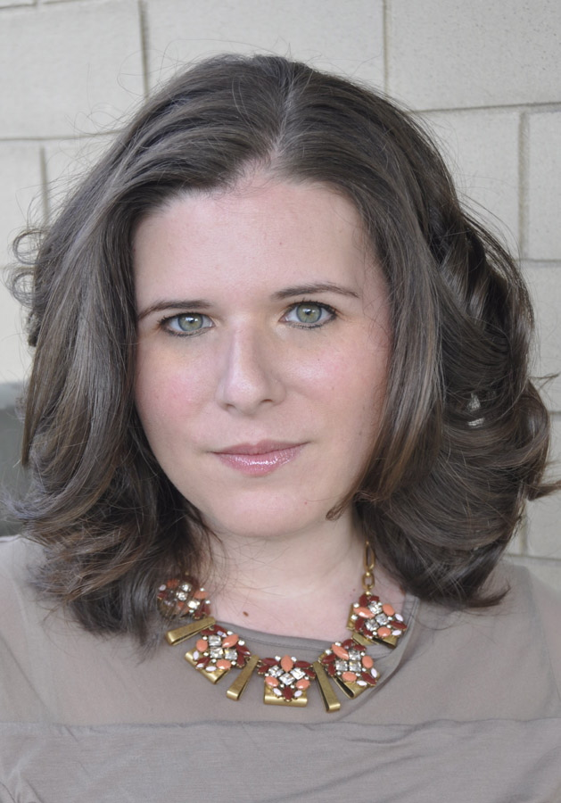
A Bit About Me
Notes:
Hi Everyone! Thanks for coming today – I’m really excited to speak to you. My name is Rachel Schneider, I’m the author of Making Sense: A Guide to Sensory Issues, which was published by Sensory World in February. I was diagnosed with Sensory Processing Disorder (SPD as we call it) in 2010 at age 27, and I have a Master’s degree in Mental Health Counseling, which all give me a pretty unique perspective on living with sensory issues.
Since my diagnosis, I started the blog, Coming to My Senses, all about my daily life with SPD, and I now advocate on behalf of the SPD community – especially adults and teens, who often go underlooked – via my blog, through articles, through books, and through speaking engagements.
I’m passionate about SPD because it’s such an important part of who I am and how I exist in the world, and I’m especially pleased to be speaking about the sensory person’s experiences with culture and the arts. As I’m sure you agree, artistic expression and cultural engagement are meaningful for all human beings, but this is especially true for those of us who experience the world around us, as well as our emotional state, more intensely. Because we interpret things differently, so many people with sensory issues feel a more intimate connection with art, music, theater, and nature.
I’ve been asked to introduce you first to SPD before discussing my own experiences with culture and the arts – I promise, it won’t be too intense! I’ll give you a crash course ☺

Slide 3
Sensory Processing Disorder (SPD)
Sensory Processing Disorder:
A neurological condition that impacts the way a person processes (takes in, reacts to) information from the eight senses, including sight, hearing, touch, taste, smell, balance, where the body ends and the world begins, and the status of internal organs.
Notes:
So SPD is a neurological condition that impacts the way a person processes – or takes in, reacts to – sensory information from across the eight senses (YES, WE HAVE EIGHT) – sight, hearing, touch, taste, smell, vestibular (or balance), proprioception (or the sense of where the body ends and world begins), and interoception (the status of our internal organs)

Slide 4
Sensory Processing Disorder (SPD)
Different subtypes of SPD:
Sensory Modulation Disorder*: over-respond, under-respond, or neglect to respond to sensory input in some combination between the eight senses (avoid, crave, or ignore input) *Rachel’s main issue
Sensory Discrimination Disorder: trouble understanding basic sensory qualities of objects, places, people
Sensory-Based Motor Disorder: trouble maintaining posture, planning and executing movements
Notes:
SPD is broken down into three main subtypes. People can have more than one subtype:
Sensory Modulation Disorder, which is the over-responding, under-responding, or ignoring of sensory input. (Often called “avoid, crave, and ignore”) – this is the subtype that impacts me the most. Each person with this SPD subtype has their own combination of modulation issues: for example, I avoid sight and sound, I crave touch – I’m a huge hugger as some of you may see later – and I ignore proprioception, or the sense of where my body’s located in physical space, meaning I tend to walk into just about everything and I don’t know where my body ends and the world begins.
Sensory Discrimination Disorder deals with the issue of not understanding the basic sensory qualities of objects, places, and people. For example, I rarely, if ever, can locate the source of an unexpected sound. People with this subtype might not be able to figure out through one sense alone what they’re detecting – like looking through a bag by touch without seeing the objects.
Sensory-based motor disorder deals with posture and the planning and executing of basic movements, like coordinating movements to button clothes.

Slide 5
SPD Doesn’t Discriminate
Children often diagnosed in childhood
Some of us go undetected until adolescence and adulthood
Notes:
Although SPD is diagnosed most often in childhood these days, I always like to point out that SPD isn’t a “childhood disorder” and doesn’t discriminate by age.
Many of us, especially in previous generations, didn’t learn about our SPD until adolescence or even adulthood.
There’s a huge community of what I like to call “delayed diagnosis sensory adults” like me who didn’t learn that their challenges had a name until much later in life.

Slide 6
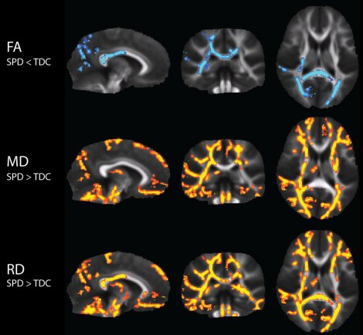
Research
UCSF Research Team: SPD is caused by differences in the brain’s wiring.
People with SPD have less white matter (or structural integrity is impaired) when compared to people without SPD.
People with SPD aren’t wired as efficiently when it comes to processing sensory information. Especially true for multi-sensory processing, or processing sensory input from multiple senses at once.
Notes:
I want to talk to you a little bit about the research.
Up until very recently, people in the sensory community suspected that SPD existed bc we were having these shared experiences. A woman named Jean Ayres first described SPD in the 60s and 70s, although in the past few decades, with the rise of information on Autism, sensory issues were often linked directly to spectrum disorders only. The only issue was many of us were displaying the sensory-sensitivity-portion of the Autism diagnosis – but that was it, and so it became clear that more research needed to be done on if SPD really existed, and what it looked like in the brain.
The SPD Foundation (who’s becoming the STAR Institute for Sensory Processing Disorder), our leading advocacy, research, and education organization, set up a working group to help establish SPD as a scientifically-proven, stand-alone condition that many people have exclusively, and many people also have as an add-on to an Autism Spectrum condition.
In 2013 (with a follow-up study in 2015), a research team out of the University of California – San Francisco was able to determine that SPD did, indeed, have a neurological origin, meaning SPD occurs when particular areas of the brain are wired in a certain way – differently from “typically” wired people. In the brains of people with SPD, the white matter, or the areas of the brain that connect other areas like a subway system – is less present or structurally impaired, making it sometimes impossible for the brain to process information from the senses smoothly and as quickly as necessary.
The image on the slide shows brain scans from the 2015 study. These brain slices are highlighted in particular areas. The highlighted portions show where the brain is actually wired differently in people with SPD. So you can SEE SPD, not just experience it. This is novel for many of us who even grew up without a diagnosis of any kind – that what we were experiencing, which felt strange, unique, and unfamiliar when described to others, is something we can see. It validates it for us.

Slide 7
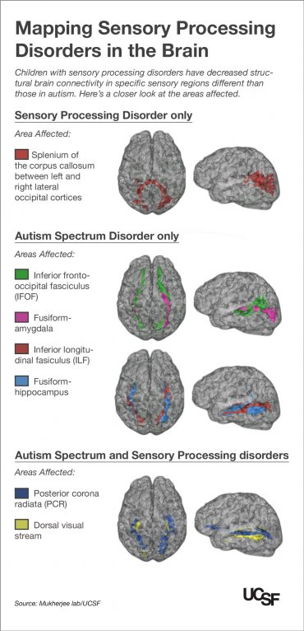
SPD and Autism
Researchers have found structural, neurological differences between people with SPD and people with an Autism Spectrum Disorder (ASD).
Different (but sometimes related/adjacent) areas of the brain are impacted.
Many people with an ASD also have SPD, but most people with SPD don’t have an ASD.
People with SPD show an even greater disconnection in areas associated with sensory processing.
SPD: no neurologically based communication/social challenges.
Notes:
In 2014, the same UCSF team undertook a study comparing the neurology of people with SPD versus people with an Autism Spectrum Disorder.
They found that different areas of the brain were impacted, and although people with SPD and people with an ASD share similar sensory traits, we differ in the areas of communication and social challenges – these are not typical SPD issues, and our wiring reflects that. They also found that people with SPD show a greater disconnection in the white matter in the areas related to sensory processing vs. those with an ASD. The image on the slide shows similar slices of the brain (like in the last slide) but highlighting the different areas of the brain that are impacted by having SPD-only, an ASD-only, and both SPD and an ASD.
The SPD Foundation says that people with an ASD often also have SPD, but people with SPD don’t typically have an ASD. I know it’s confusing!
I always share these tidbits of information for clarity’s sake. When I tell people that I have SPD, they sometimes think I’m on the spectrum, which isn’t true – and because my role in the community is so based on expressing my personal experiences, I want to be clear what those experiences are.
I also think the delineation between the two different – but related – conditions is important because we’re working to reflect the experiences people are having in general in order to be supported and accommodated properly. We need to be clear about what we have to ensure proper treatment, and also acceptance and understanding by loved ones and ourselves.

Slide 8
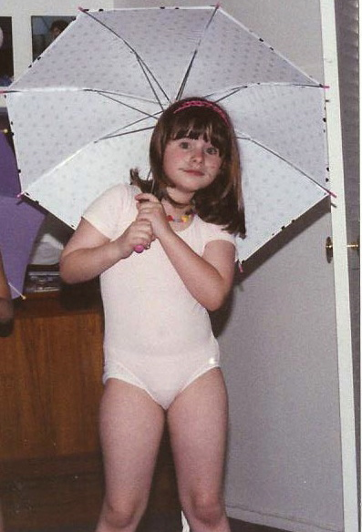
My Experience with Arts and Culture
Notes:
Okay, so that takes care of your crash course on SPD. I know you’re all experts now LOL. If you have more questions about it, please read my book ☺ Also feel free to grab me later –there’s a 15 minute break after I speak, or so I hear - and ask me questions.
So the reason we’re all here today is to discuss sensory issues and culture. Nothing makes my heart fuller and simultaneously makes my heart ache more than thinking about the relationship between my SPD and my lifelong love of the arts. The arts engage the senses; they tend to take place in large, unfamiliar, echoey buildings – or even in wide, open, outdoor spaces; they can be quiet and peaceful – like looking a Monet – but they can be loud and engulfing, like listening to a jam band at a summer festival.
In figuring out the best way to explain this all to you, because it’s complicated, I’ve pulled a few paragraphs from a short story I wrote a few years ago about my experience with musical theater. I hope you’ll hear the complexity in my expression – the dichotomy of loving something that is just sometimes beyond my ability to do. And it’s ultimately the reason why sensory friendly programming is just SO important to the general sensory community.
(as a quick aside, the photo on the slide is of me at age 5, decked out in ballet gear and an umbrella, for some reason, reenacting the show I discuss next)
“In one moment, I had zero interest in tabbies and tomcats, and in the next, I was enthralled. The feline era of my life was ushered in via the fanfare of Broadway by way of the musical CATS. In celebration of my first half-day of Kindergarten, my parents took me to a matinee performance. I had never been inside of a Broadway theater before, and I was instantly taken aback by the endless sea of red-cushioned chairs and the sprawling stage. My gaze alighted from one new sight to the next. I looked up to see the intricate cage of lighting lacing the ceiling, and back down as an usher pressed my first Playbill into my palm. Watery, yellow cat eyes gazed at me from the cover; two dancers, mid-motion, were paused in the thick of dark pupils.
“Let’s go see the orchestra pit!” said my mother, as she and my father whisked me down the thickly carpeted aisle.
We waded through rows of seats until we could practically lay our hands on the lip of the stage. Looking up, I marveled at how very small I felt. The set featured soapboxes, tin cans, discarded newspapers, and other debris – each item thousands of times larger than its real-world counterpart. My father lifted me into his arms, and together we leaned down into the orchestra pit, where more than a dozen people were preparing their instruments. A trumpeter, cheeks wide and taught, blew a few sharp notes while a flautist delicately maneuvered her fingertips up a long, silver flute.
When the house lights dimmed, we quickly walked back to our seats as the orchestra began to surge with the overture. Rife with anticipation, my skin tingled in tune with the urgent, haunting melody, and my heart raced forward with each ravenous plink of the glockenspiel. It was as if we were collectively headed somewhere, away from the gum-lined sidewalks and roasted nut vendors of Times Square, and into a universe where toilet paper rolls were the size of cars.
After CATS came the simplicity of A Chorus Line, the enchantment of Meet Me in St. Louis, the regality of 1776, the sassiness of Annie Get Your Gun. I loved them each in turn, tenderly filing away each precious Playbill, until my stack outgrew its designated white laminate cabinet and was relegated to a packing box somewhere at the back of an attic.
In time, I’d find it too complex to sit in felt-lined seats and watch in wonder as the improbable unfolded before me in song for hours at a time. It was as if my abilities degraded, particularly in the face of Broadway. My eyes would burn against the spotlights, turning the protagonist to sharp fragments of an incomprehensible whole. My ears would vibrate with the highest falsetto, but no words would be identified. A sensory jumble, a tug-of-war, I would see and then I would hear, but I would not be able to join the two in quite the same way I did back when I saw my first Broadway show.
In my 20s, while seeing RENT for the second time, I would shoot up from my seat minutes after Mark began strumming his guitar in narration. I would cover my ears and squint and run away from the stage, as if I had been set ablaze by a stranger’s rogue match. I would find myself cowering in the restroom, attempting to step foot once again outside the bathroom door, but the theater would be so saturated in song that even from where I stood, hovering by the exit, my ears would ache in some unknown assault. I would eventually flee from the Nederlander Theatre, a refugee, no longer welcome in the land I used to call my home”

Slide 9
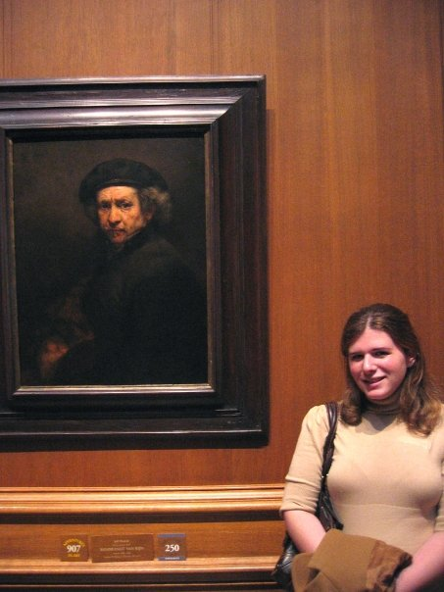
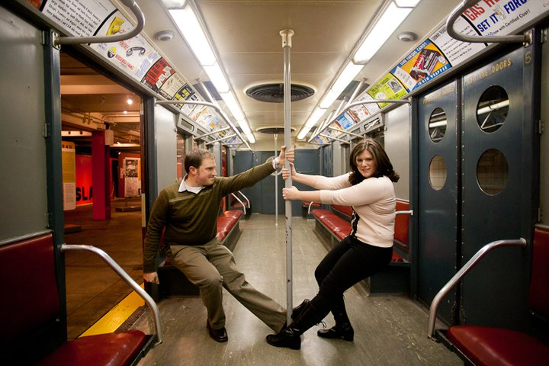
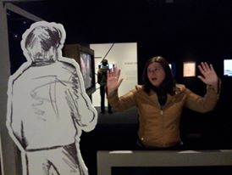
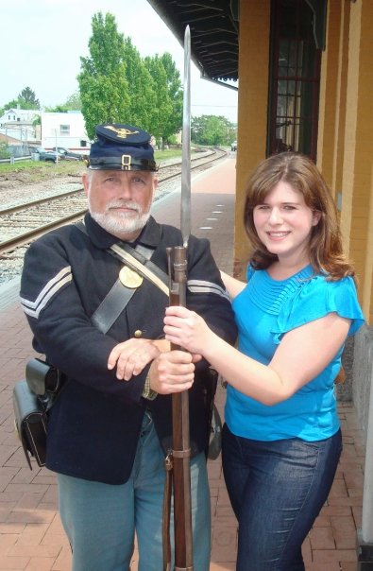
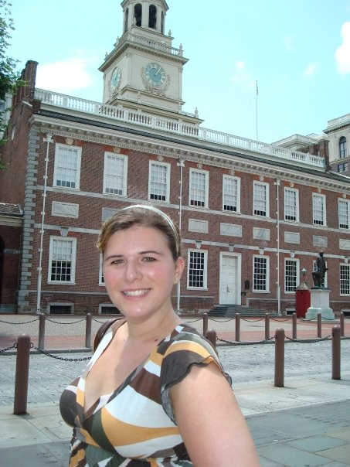
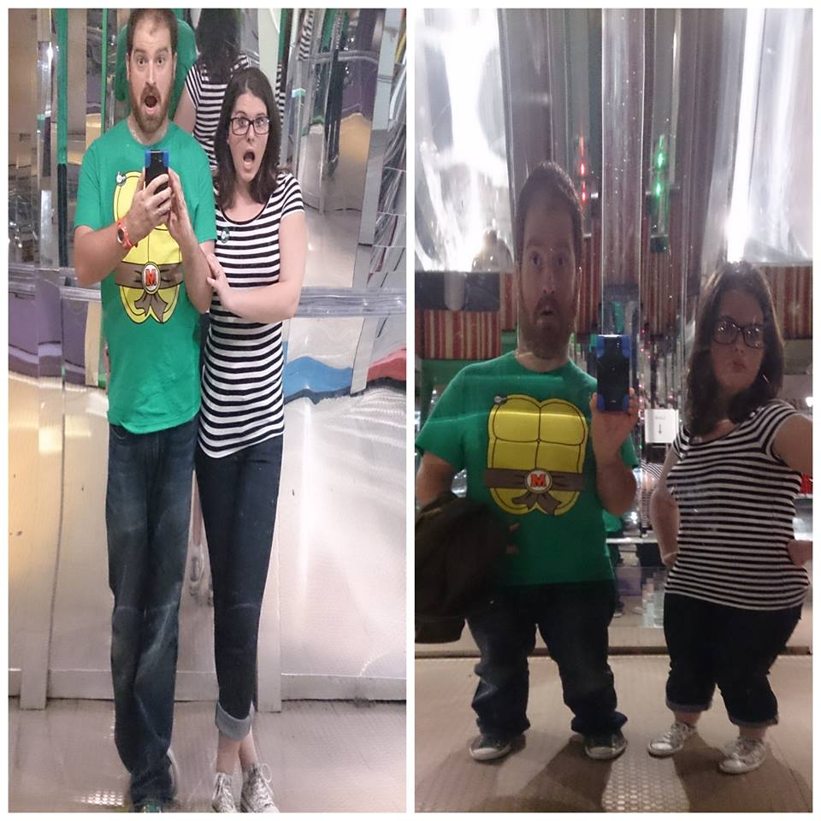
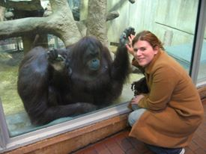
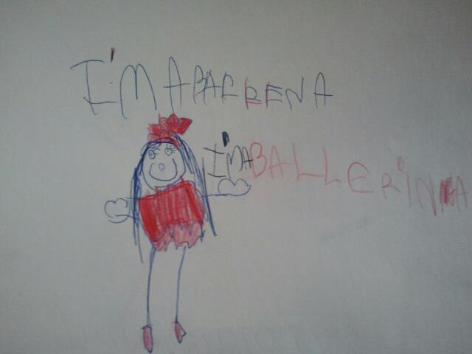
My Experience with Arts and Culture
Notes:
And with all that, I still love the arts and culture as the photos on this slide show.
It’s important to note that I’m the daughter of an art consultant mother and an amateur astronomer father (both theater lovers, by the way), so my childhood was filled with visits to The MET, MoMA, The Museum of Natural History, science museums, the Bronx Zoo, the NY Aquarium, and of course, as I just explained to you, Broadway. I learned to play piano at a young age, I wanted to be a ballerina for the longest time (that clearly didn’t happen), and to this day, I still write poetry. If you asked me what sort of person I was, I’d almost always answer “creative.”
In spite of my sensory challenges, I’ve found ways to participate in arts and culture. My own rule in my sensory life is “if it makes you feel bad, don’t do it.” It’s why I ultimately stopped going to the theater – although I’m so happy to know that the Theatre Development Fund has been working with such dedication to help people with sensory issues experience theater, because nothing compares to the majesty of the stage, in my opinion.
These days, my amazing husband Josh and I have found the best ways for us to visit cultural institutions. We go when I know I’m the freshest – earlier in the day – and we take our car, so I’m not overwhelmed by public transportation before I even step foot inside of the museum or library or zoo. I look up each place we’re headed before we even leave, so I’m familiar in part with the look and layout of the venue. I’m realistic about how I’m feeling that day – how sensitive I am – and we look at the available exhibits and pick one or two that really speak to us. When I’m done, I’m usually VERY done, and he’s amazingly flexible with accepting that and helping me leave if I need the help. I call him my “handler” (something that has wonderfully taken off in the adult community – our helpers, our partners, are our handlers), and he’s equipped to support me if my sensory system fails and I go into a shutdown, meaning I can no longer see, hear, understand where my body is in space, or make sense of sensory input in general.
You’d be amazed how helpful a hand-squeeze is in the middle of a visually-overwhelming exhibit, and how pivotal it is to have someone next to you who can guide you out of the labyrinthine (labor-IN-thin) halls of an aquarium at a moment’s notice.

Slide 10
What SPD May Look Like in Arts/Culture Setting
(AVOID) Fearing going to a museum, zoo, concert, or theater – concern about being overwhelmed
Overwhelm can lead to meltdown or shutdown
(CRAVE) Overly-engaged with cultural event. Wanting to touch all of the animals, press face or body up against booming speaker, hold objects, participate
(IGNORE) More likely to be injured on premises, may seem disengaged
Discrimination Subtype of SPD: issues with identifying source of sound, touch to ID what they’re seeing.
Sensory-Based Motor Disorder: might be watchers and not participators
Notes:
SPD is an invisible condition, but if you look closely enough at the behaviors of others in your institution, you might be able to detect the underlying neurological differences in your midst.
In an arts or cultural setting, people who fall into that first subtype of SPD I mentioned earlier – Sensory Modulation Disorder – typically avoid, crave, or ignore sensory input in some combination.
In an avoider, you may see them fearing going to a museum, zoo, concert, library, or theater, especially since sensory overload can lead to a meltdown (which is a tearful, angry episode) or a shutdown, which is more anxiety-driven. They might be most open to quieter, smaller venues and less stimulating art-forms.
People who crave sensory input might absolutely love things like concerts, hands-on science exhibits, the theater – you might see them wanting to touch everything or even hold the objects or participate somehow.
People who ignore sensory input are the most likely ones to get injured on the premises, as they’re so unaware of what’s transpiring. They might seem uninterested or disengaged, but it doesn’t mean that they’re not thrilled to be there.
In terms of the second SPD subtype, Sensory Discrimination Disorder, these individuals might have issues with determining the source of music or the spoken word – they might even have the urge to touch the art, the animals, the exhibits in order to understand what they’re seeing, hearing, and experiencing.
People with the third subtype of SPD, Sensory-Based Motor Disorder, struggle with putting movements together in sequence, so they might be more willing to watch rather than participate (especially in the areas of dance and in hands-on exhibits)

Slide 11
Tips to Help Guests with SPD
Recognize that their needs are sensory-based
Think about how all eight senses come into play in your institution
Consider a sensory-friendly hour, day, half-day
Consider a quiet space for escape
Exhibits near exits = less stressful
Recognize meltdowns and shutdowns
Notes:
So what can you guys do as representatives of your cultural institutions to help guests with SPD?
The issue here is that the SPD experience varies so widely – from people who can’t tolerate input to people who are ravenous for it. I’m not sure that there’s a cure-all to suit everyone’s particular needs, and so most guests will bring tools and use techniques to help them with their own array of sensory issues.
However you can take a few things into consideration:
Understand that the needs of people with SPD are 100% sensory-based, and think about each sense in terms of your institution. Do you have overwhelmingly bright fluorescent lighting, or can you open the drapes and let natural light in somehow (or can you even dim the lighting?) Can you adjust the sound to be less overwhelming for the most hypersensitive visitor? Can you make some of your exhibits less visually-stimulating? (Although again a craver would want it louder and brighter and more stimulating . . .)
Maybe you want to consider a sensory-friendly hour, day, or half-day where people with sensory issues can visit under less intense circumstances. Perhaps you limit the number of visitors, play with the lighting or sound or visual flow to make it a more soothing and less overwhelming environment. This won’t be as engaging for those who crave input, but to be honest, our current society is so stimulating that the cravers will probably prefer to visit during very busy peak hours, and so this sensory-friendly time would be more for the avoiders who struggle to get out and process without feeling awful.
You might want to consider setting aside a quiet room for people who need a break from the sensory input of your cultural event.
And I’m not sure how feasible this one is, but I know personally that exhibits near exits feel less stressful or anxiety-provoking for people who are avoiders. You can’t really add exits, but maybe make better use of those sorts of spaces for exhibition purposes.
Finally, I think it’s important to recognize meltdowns and shutdowns – I cover these in depth in my book – and perhaps see if your staff can be trained on what these look like – not just in kids, but teens and adults too, with SPD as well as an ASD – so that they can offer assistance or guide someone to a quieter space during one of these neurological episodes.

Slide 12
Breathing Room
Notes:
Pulitzer prize winning author, John Updike, once said “what art offers is space – a certain breathing room for the spirit.”
We all deserve that space, that breathing room – whether we’re participating in the arts and in culture through our own hands or body, or whether we’re adoring spectators.
This includes people with sensory issues.
The more you can think about ways in which to include us, the more we’ll be involved – the more we’ll be exposed to that space, that breathing room, that thing that ties all human beings together.

Slide 13
Follow Me!
MY BOOK: www.rachel-schneider.com
BLOG: comingtosenses.blogspot.com
WEBSITE: www.rachel-schneider.com
FACEBOOK: https://www.facebook.com/coming2mysenses
TWITTER:@coming2mysenses
PINTEREST: https://www.pinterest.com/coming2mysenses
Notes:
That’s all the time we have for me today – although as you can see, I could talk about SPD for hours and hours.
I hope you’ll buy my book – flyers about it, and my business cards, are [ON THE TABLE?]
Please do find me online at www.rachel-schneider.com – all of my social media efforts, like my articles, blog, FB, Twitter, and Pinterest are all linked through there.
It’s been a pleasure speaking with you. Again, I’ll be around during the 15 minute break if you have any questions or want to chat.
Thanks again to Kelly, Christena, Lynn, and the CCAC for having me here today . . . and to all of you – for listening, but for caring enough about people like me to want to make our experiences in your institutions as successful and positive as possible.

