Slide 1
Development 101
Hilary Odom
Director of Corporate and Foundation Relations
Chicago Shakespeare Theater

Slide 2
Your organization’s trusty development officer…
…perception

Slide 3
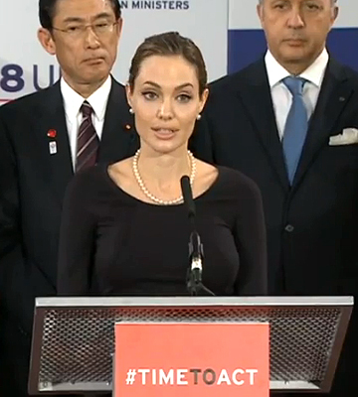
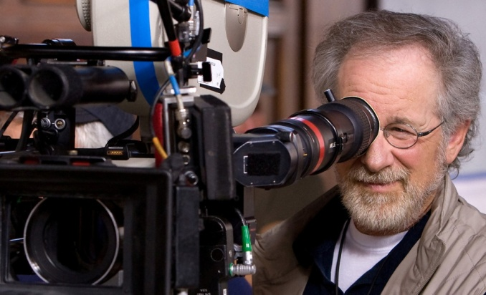
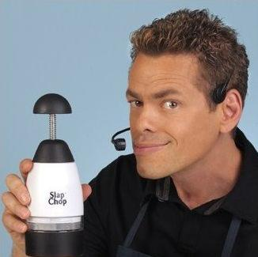
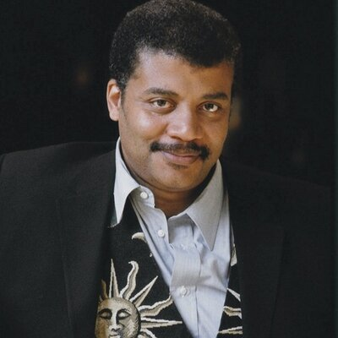
Your organization’s trusty development officer…
Story Teller
Advocate
Matchmaker
…reality
Spokesperson
Researcher

Slide 4
Donor Motivation: Building strong relationships
BOARD MEMBERS
 Your biggest fans!
 Personal/Professional investment
 Civic Leadership
INDIVIDUAL DONORS
 Emotional connection to the work
 Direct community impact
FOUNDATIONS
 Mission-based investment
 Demonstrated results
CORPORATIONS
 Brand/Values alignment
 Employee engagement
 Local community investment

Slide 5
Our information toolkit…
Quantitative
Qualitative
Participation
Letters
Photo/video documentation
Outreach
efforts
Partnerships
Survey
results
Anecdotes
Email
responses
Published research
Direct feedback (participants and staff)
Demographics
Trends
Services offered
Observation
Frequency
of service
Social media engagement

Slide 6
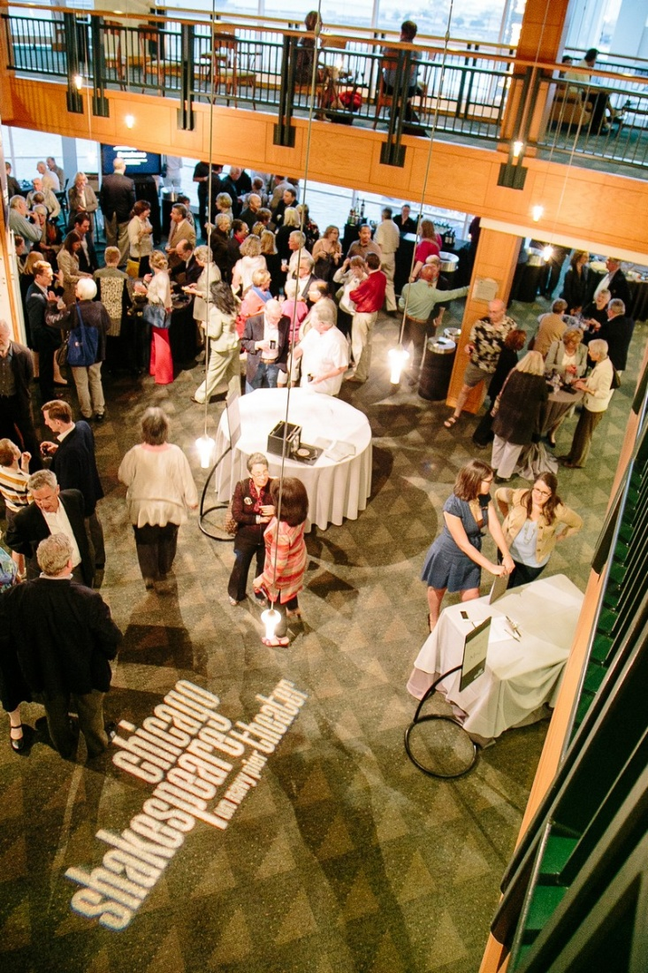
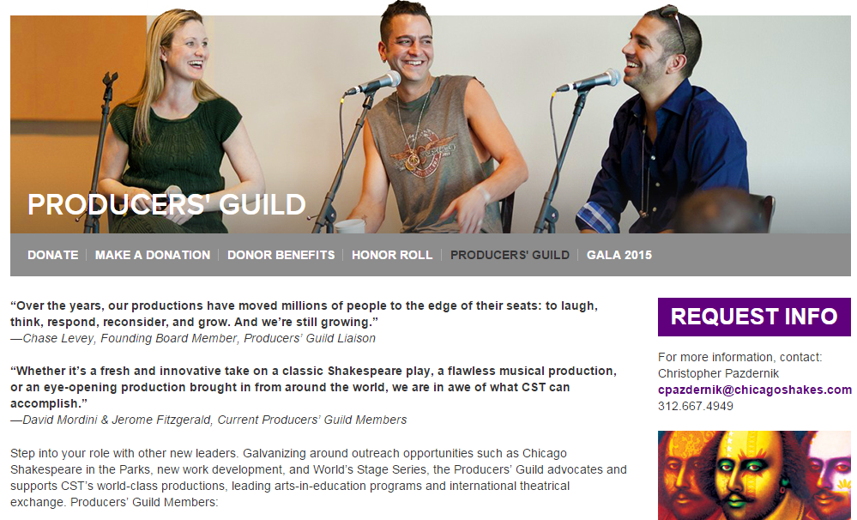
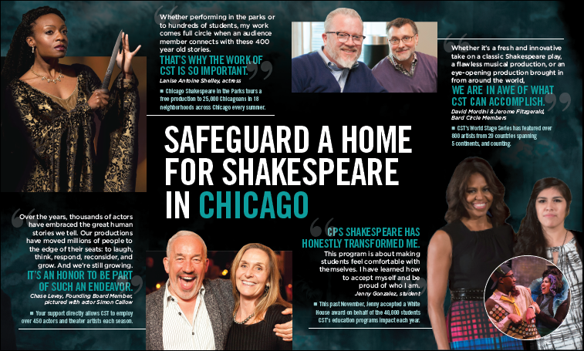
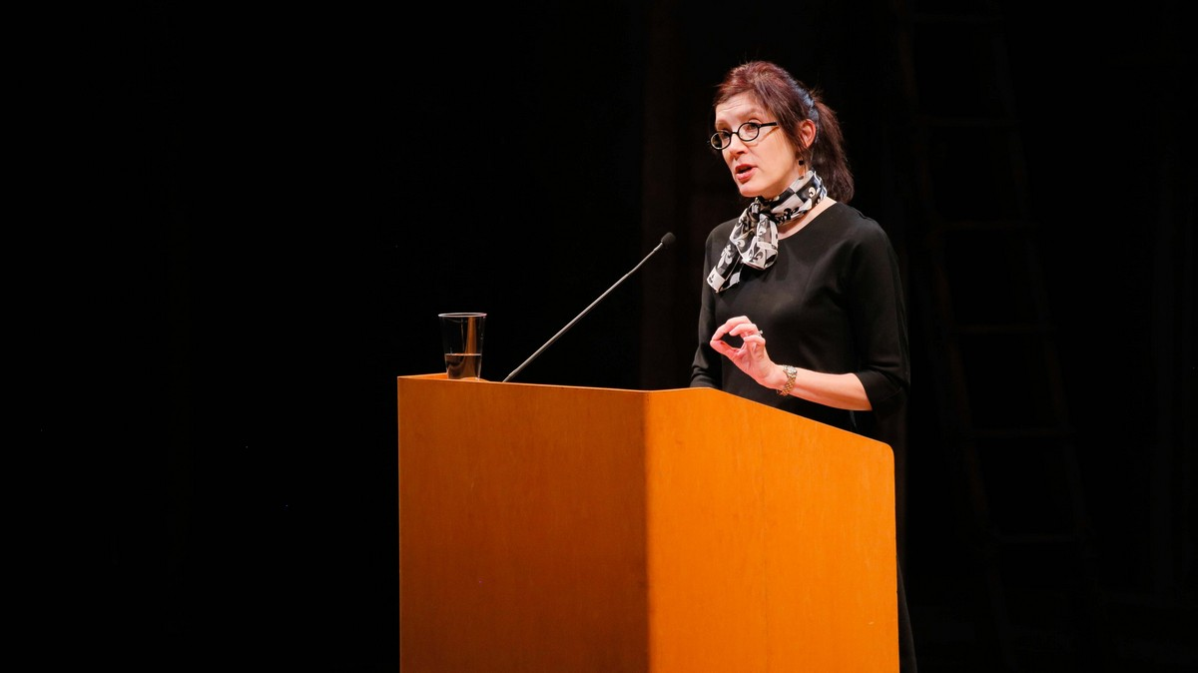
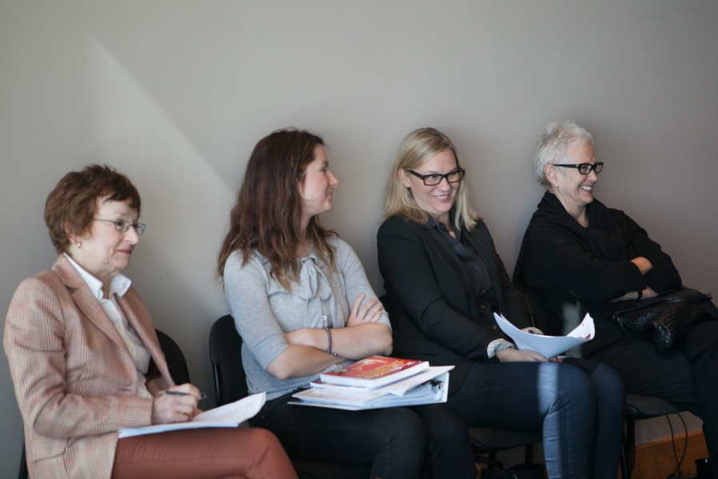
…to create donor-centered communications

Slide 7
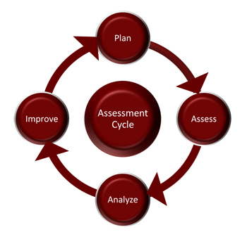
Program Evaluation
“The unexamined life is not worth living.” –Socrates
What do you hope to achieve?
How do you know this is realistic?
How will you know if you are on track?
What methods can you use to improve how your program operates?
How will your short-term achievements contribute to a longer-term impact?
This is your opportunity to provide real-world context for your program results!

Slide 8
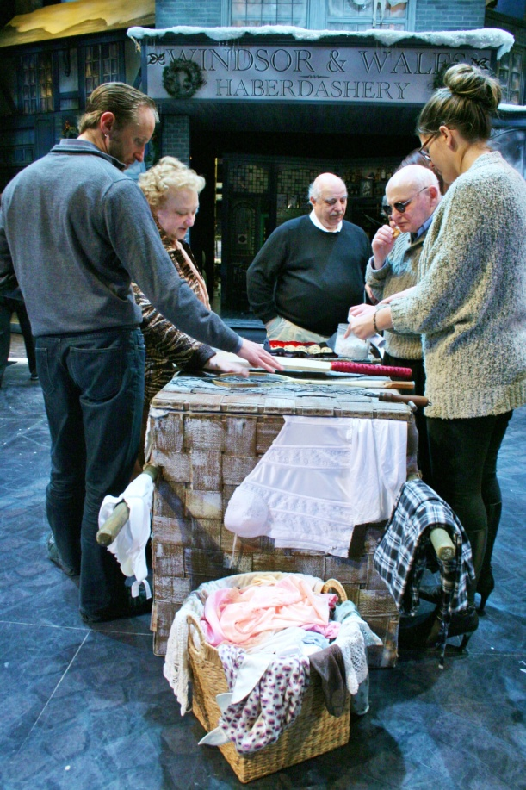
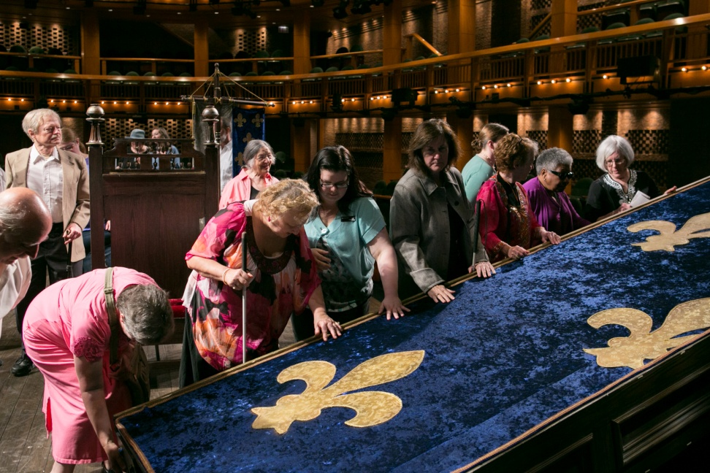
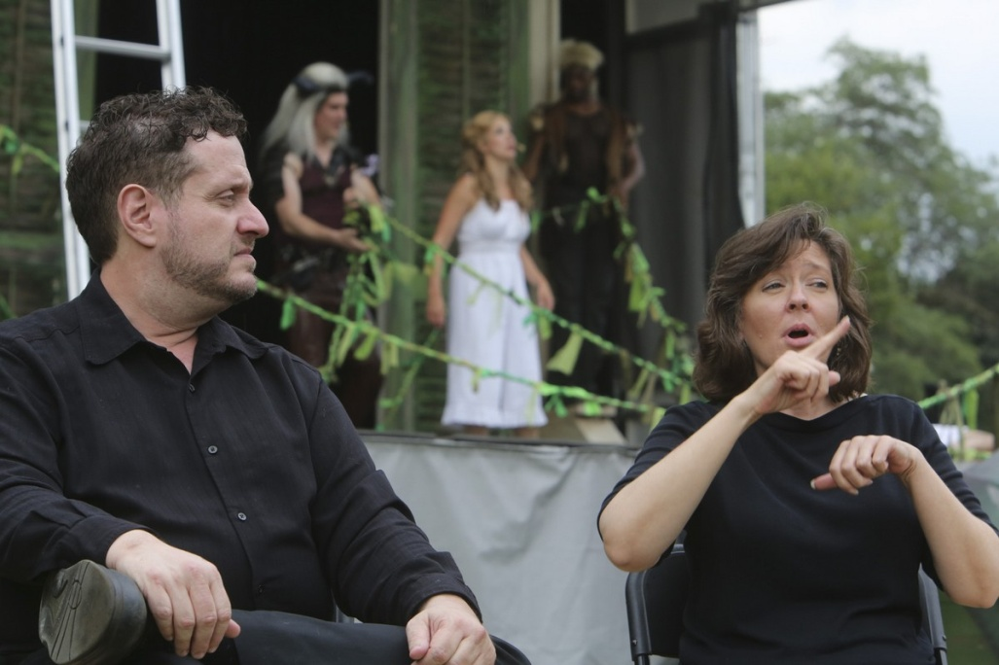
Program Budget
“Mo money, mo problems.” –Notorious B.I.G.

Slide 9
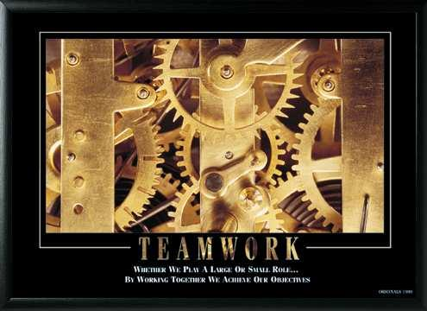
Parting Thoughts…

